Slide 1
Protozoa

Slide 2
CLASS: ZOOMASTIGOPHOREA
Absence of chromatophores (chloroplasts).
There are one to many flagella, often undulating membrane is present.
Holozoic or saprozoic nutrition.
Parasitic, commensal or symbiotic.
Reproduction through binary fission.

Slide 3
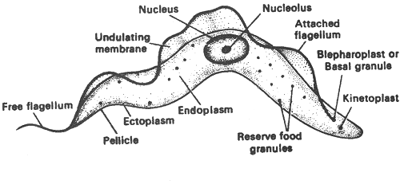
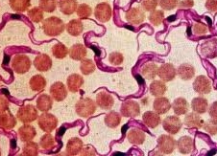
Animal Kingdom Subkingdom: Protozoa Phylum: Protozoa Subphylum: Mastigophora Class: Zoomastigophorea
e.g.: Trypanosoma

Slide 4
Habitat:
Trypanosomes are parasitic flagellates. They usually live in two hosts, an invertebrate, either insect or leech (intermediate host) and a vertebrate host (definitive or final host).

Slide 5
Morphology:

Slide 6
Locomotion:
By the vibrating movements of the undulating membrane and the flagellum, thus the body moves in a similar manner.
Nutrition:
They are capable to engulf small droplets of blood plasma by a process known as pinocytosis.

Slide 7
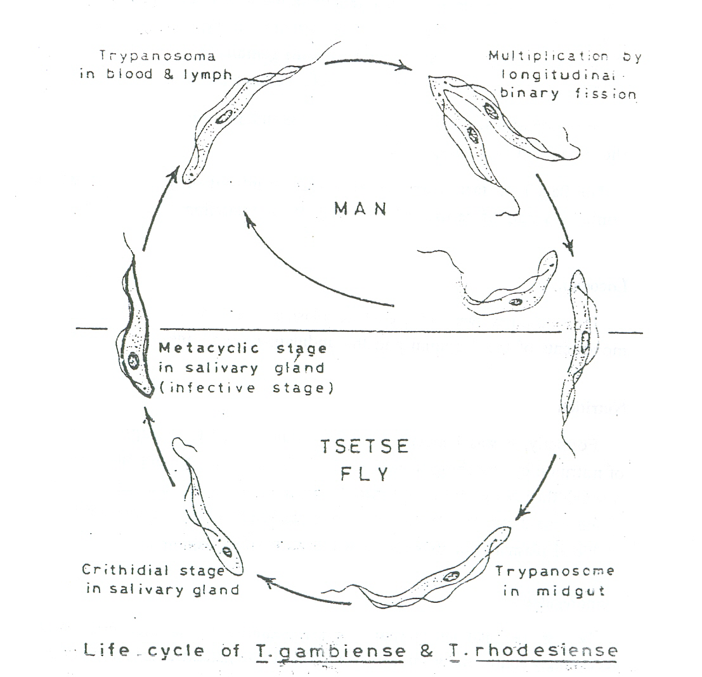
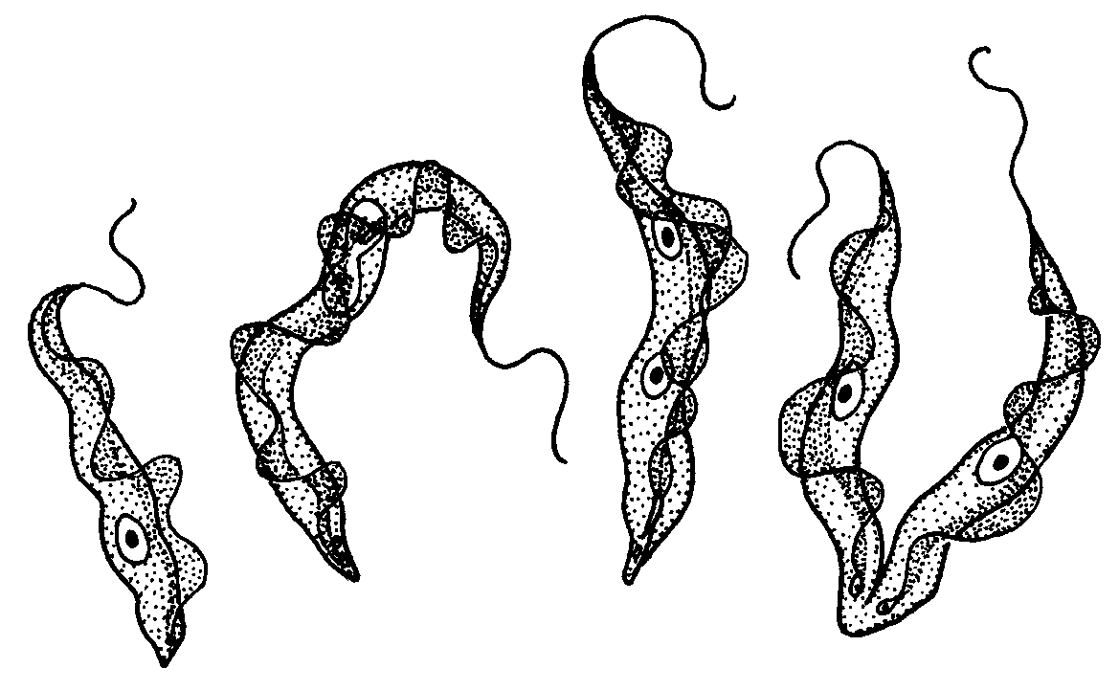
Life cycle of Trypanosoma
Longitudinal binnary fission

Slide 8
Subphylum: Sarcodina
Body is amoeboid.
Locomotion and feeding by pseudopodia.
Single nucleus.
Nutrition is holozoic, saprozoic.
Reproduction mostly by binary fission.
Most species are solitary and free-living, some species are parasitic

Slide 9
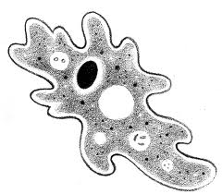
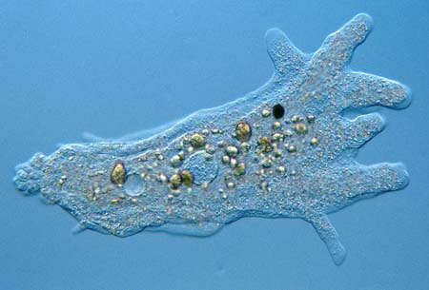
Kingdom:Animalia Subkingdom: Protozoa Phylum: Protozoa Subphylum: Sarcodina
e.g. : Amoeba

Slide 10
Morphology

Slide 11
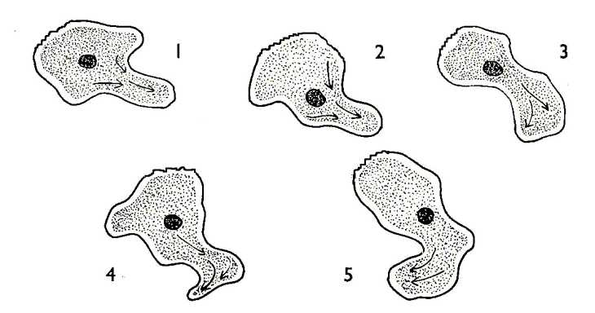
Locomotion in Amoeba By an amoeboid movement which takes place by pseudopodia.

Slide 12
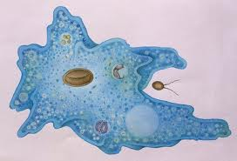
Nutrition in Amoeba

Slide 13
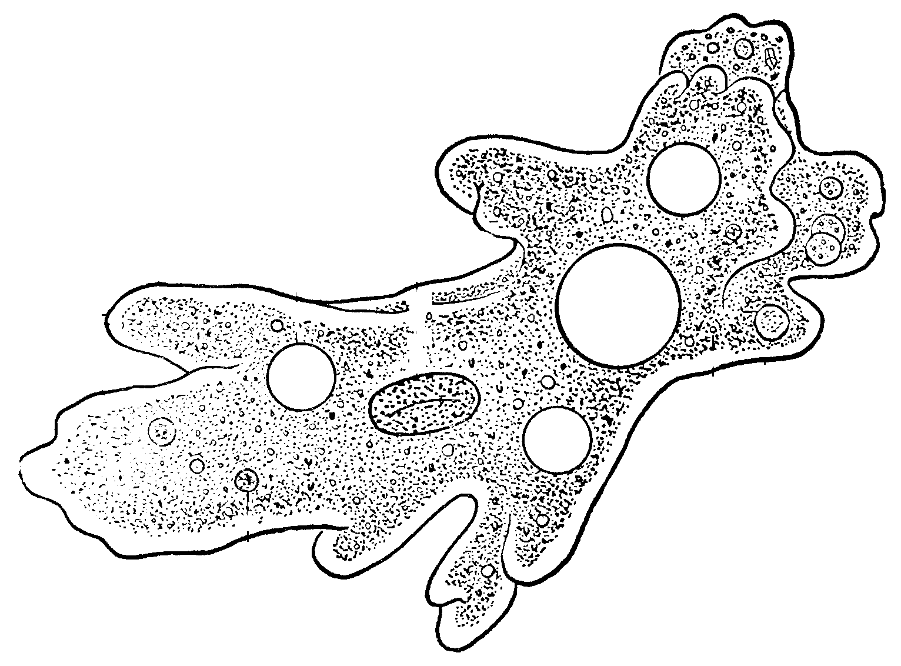
Osmoregulation
Resbiration and Excretion

Slide 14
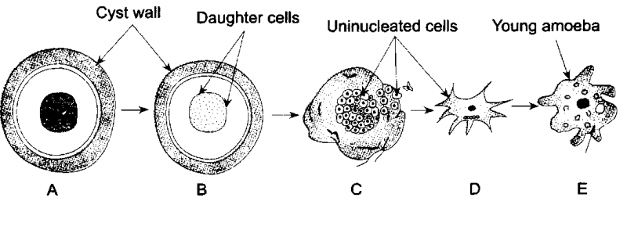
Reproduction in Amoeba
a. Binnary fission
b. Encystment

Slide 15
Subphylum: Ciliophora
Simple and compound cilia, the organs of locomotion are present.
They have two types of nuclei, a small 'micronucleus' and a large 'macronucleus'.
Nutrition is holozoic.
Most of them are free-living, and few are parasitic.
Reproduction may be asexual or sexual.

Slide 16
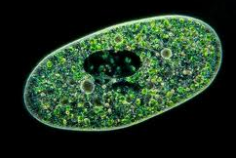
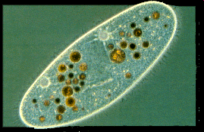
Kingdom:Animalia Subkingdom: Protozoa Phylum: Protozoa Subphylum: Ciliophora
e.g.: Paramecium

Slide 18
Locomotion

Slide 19
Nutrition

Slide 20
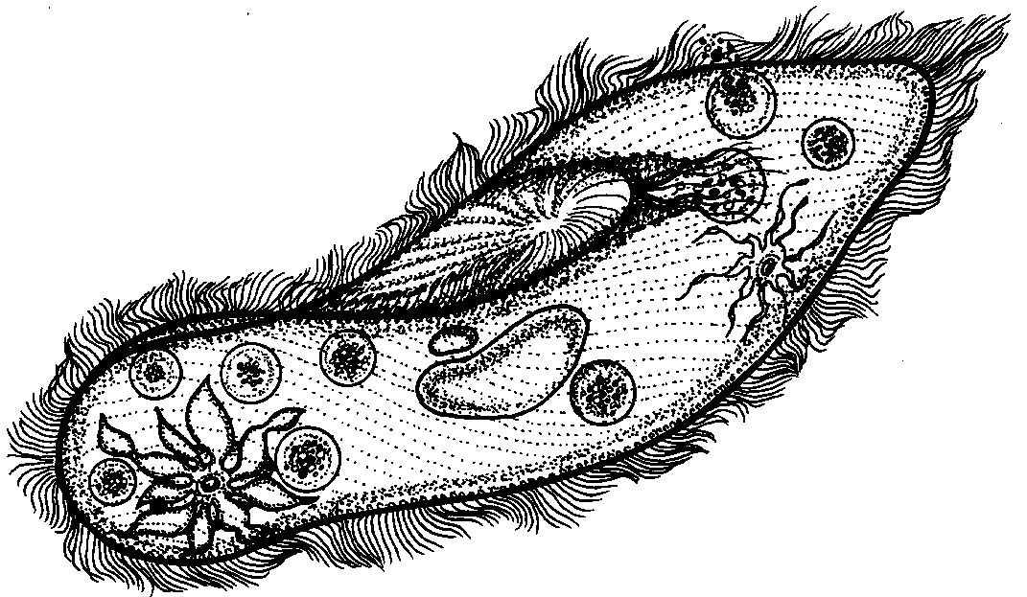
Osmoregulation
Respiration and Excretion

Slide 21
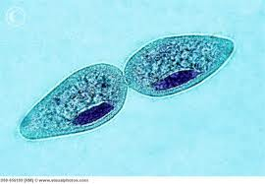
Reproduction in Paramecium
a. Transverse Binnary Fission

Slide 22
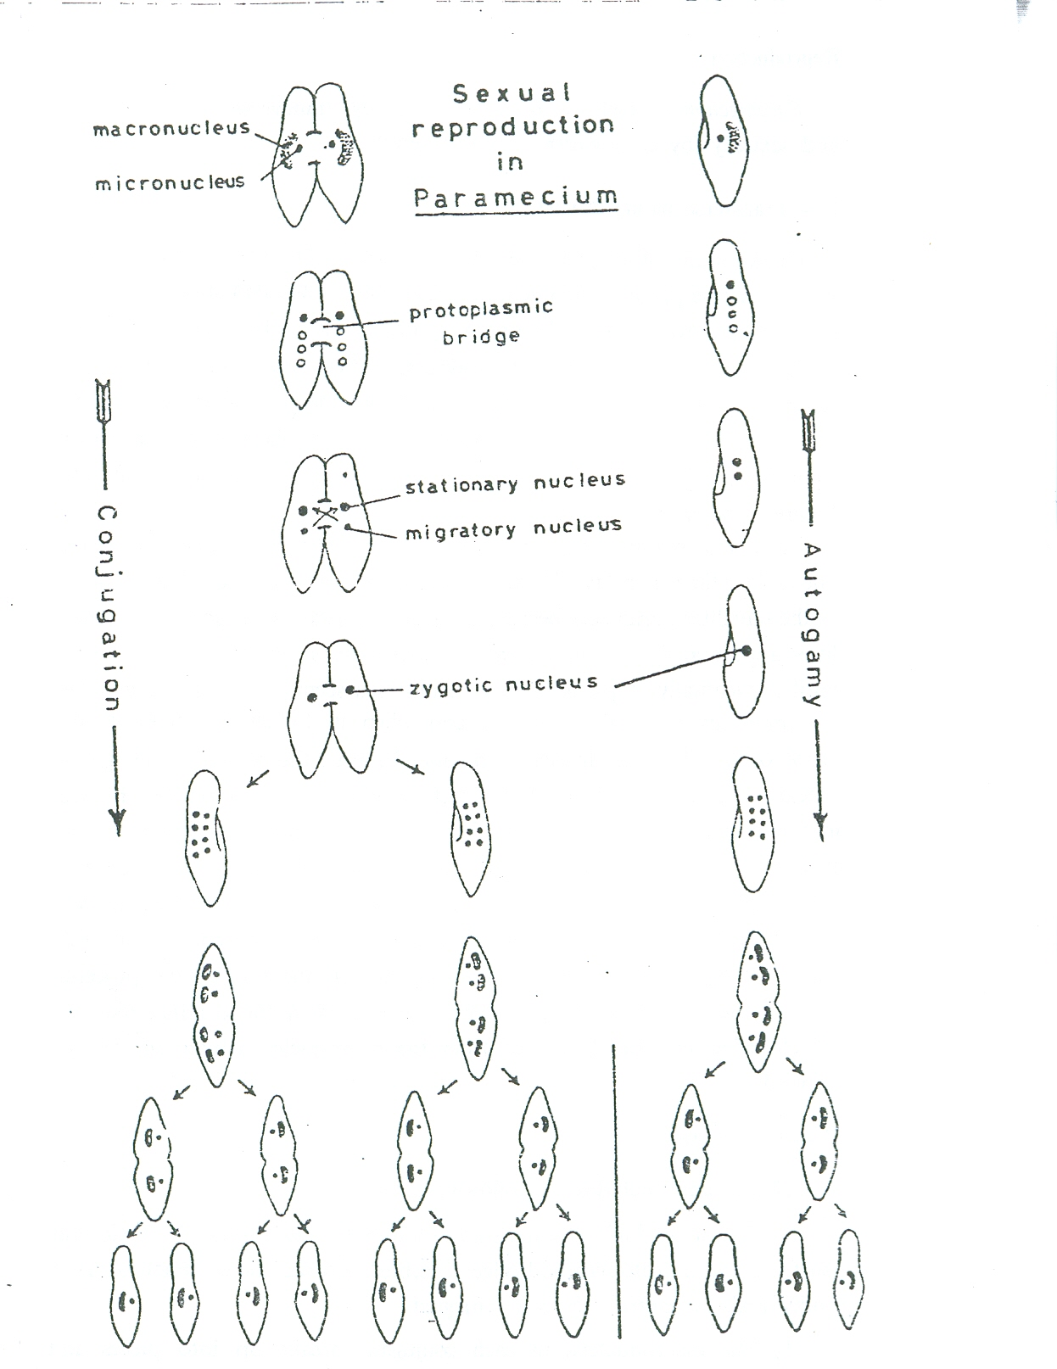
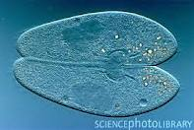
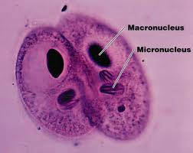
b. Conjugation

Slide 23
Conjugation: This process includes the following steps:
Two individuals become sticky, adhere to one another by their oral surfaces and a protoplasmic bridge is formed between them. Each of these individuals is referred to as a conjugant.
The macronucleus in each conjugant breaks into pieces and ultimately degenerates. In the meantime the micronucleus divides twice by mitosis to form four nuclei, each with the normal diploid number of chromosomes. Of these four nuclei three degenerate and only one is left.
The remaining nucleus divides by a reduction division (meiosis) into two nuclei; a small migratory (male) nucleus and a larger stationary (female) nucleus. Each of these two nuclei is haploid, containing half the number of chromosomes found in the original nucleus.
The migratory nucleus in each conjugant becomes active, move into other conjugant and fuses with the stationary nucleus therein. Thus in each conjugant a zygotic or fusion nucleus is formed which contains the original diploid number of chromosomes. When this fusion is completed, the two pairing paramecia separate and they are now refered to as the exconjugants.
The zygotic nucleus in each ex-conjugant divides thrice forming eight nuclei each with the diploid number of chromosomes. Four of these nuclei enlarge and become polyploid, thus forming macronuclei; while the other four remain as diploid micronuclei. This is followed by two cytoplasmic divisions and accordingly four new daughter paramecia are produced from every ex-conjugant, each with one macronucleus and one micronucleus.

Slide 24
مع تمنياتى لكم بالنجاح والتوفيق
لمزيد من المعلومات
http://www.bu.edu.eg/staff/doaamohamed7-courses

